Slide 1
Healthy, Safe and Active Lifestyles
Lesson 1-

Slide 2
Introduction
Learning Intention: We are learning to identify the 5 food groups and analyse what we eat
Success criteria
1 star – I can identify the 5 food groups
2 star – I can identify the food groups and create a food diary
3 star – I can identify the food groups, create a food diary, and correctly categorise my foods

Slide 3
Australian Guide To Healthy Eating
Can you identify the 5 food groups?
Write the 5 food groups in the space provided on your worksheet
Once you think you have all 5, go to the next slide and see how many you got correct

Slide 4
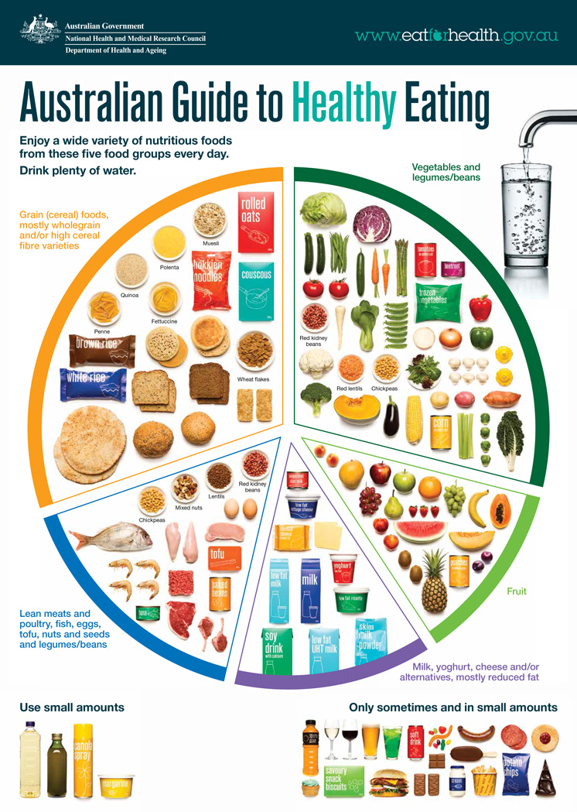

Slide 5
Food Diary
You are now to use your worksheet to create a food diary
In the table provided you are to write down everything that you had to eat or drink yesterday
Make sure to add everything, don’t leave anything out!

Slide 6
Sorting My Food
Using your food diary that you have just created, you are to now sort your foods into the Australian Guide To Healthy Eating’s categories.
You may use the diagram from slide 6 to help you

Slide 7
Cooking Lesson
SISA teacher Mr. Lowndes has provided an at home cooking lesson for you to complete with your family.
Follow the link below to access this video
https://youtu.be/vQUjap5wNow
He has cooked a healthy spinach and tomato omelette and would love to see you get in the kitchen and have some fun cooking with your family

