Slide 1
Stage 1 Online Learning Term 3 Week 6

Slide 2
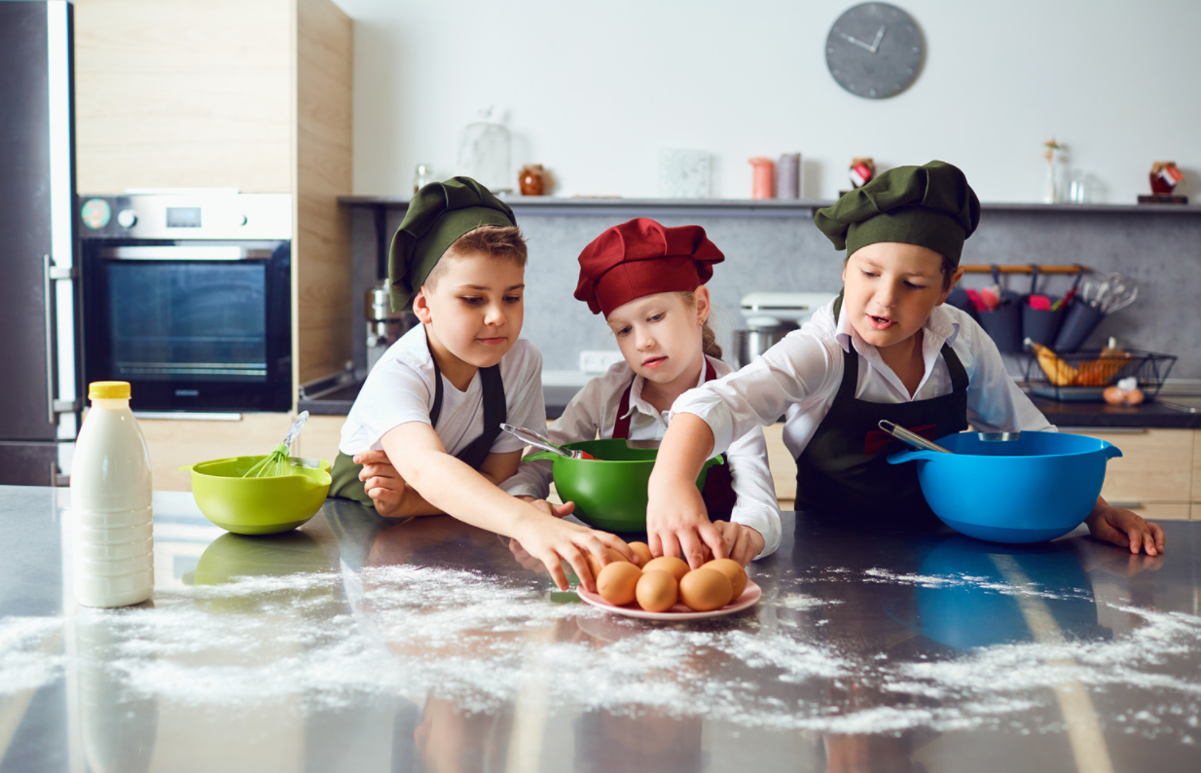
Stage 1 Online Learning Week 6
This week you will be watching a cooking lesson video from SISA teacher Mr Lowndes.
He has cooked a healthy spinach and tomato omelette and would love to see you get in the kitchen and have some fun cooking with your family.
www.sisa.com.au

Slide 3
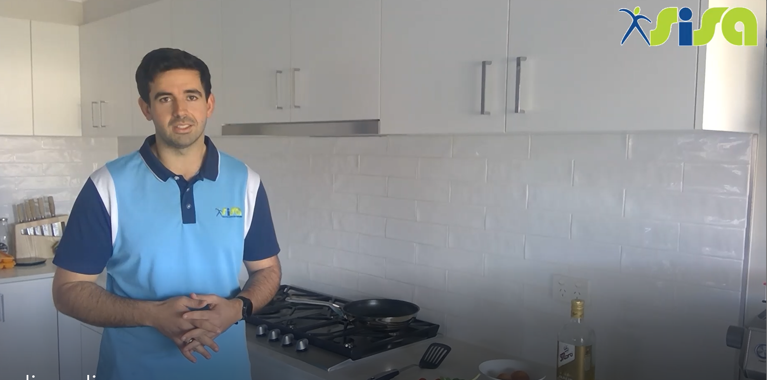
Healthy Breakfast Recipe
Click on the following link to watch Mr Lowndes cook a delicious healthy breakfast. Over the week you may like to use this recipe yourself.
https://www.youtube.com/watch?v=vQUjap5wNow
www.sisa.com.au

Slide 4
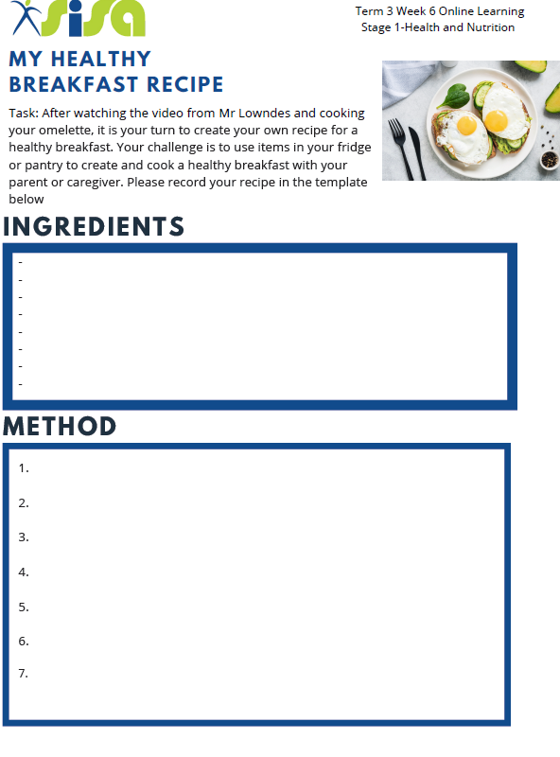
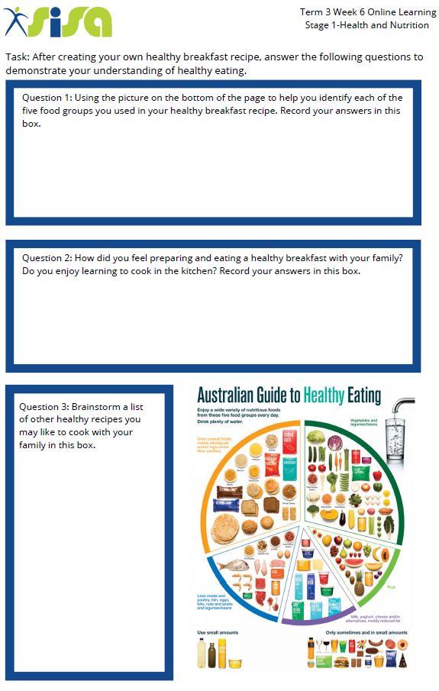
Your Turn !
Task: After watching the cooking demonstration from Mr Lowndes, upload photos or videos of yourself to Seesaw or Google classroom for your teacher so see your delicious cooking!
Then, create your own recipe for a new healthy breakfast idea that you may want to cook your family another time. Please answer the questions on page 2 to demonstrate your understanding of healthy eating.
Please use the template provided by your teacher.
www.sisa.com.au

