Slide 1
Stage 1 Online Learning Term 3 Week 5

Slide 2
Stage 1 Online Learning Week 5
This week you will be completing a daily fitness challenge and recording your results in a column graph.
Then you will be answering questions to interpret the data you collected.
www.sisa.com.au

Slide 3
Week 5 Fitness Challenge:
Challenge. Using a stopwatch or a timer, complete as many squats in 1 minute.
What you will need:
Stopwatch or timer
Small amount of space
Demonstration video
Somewhere to record your score
Click on the video on the next slide to see the demonstration of how to perform the squat correctly. Follow along with the video as a warmup
www.sisa.com.au

Slide 4
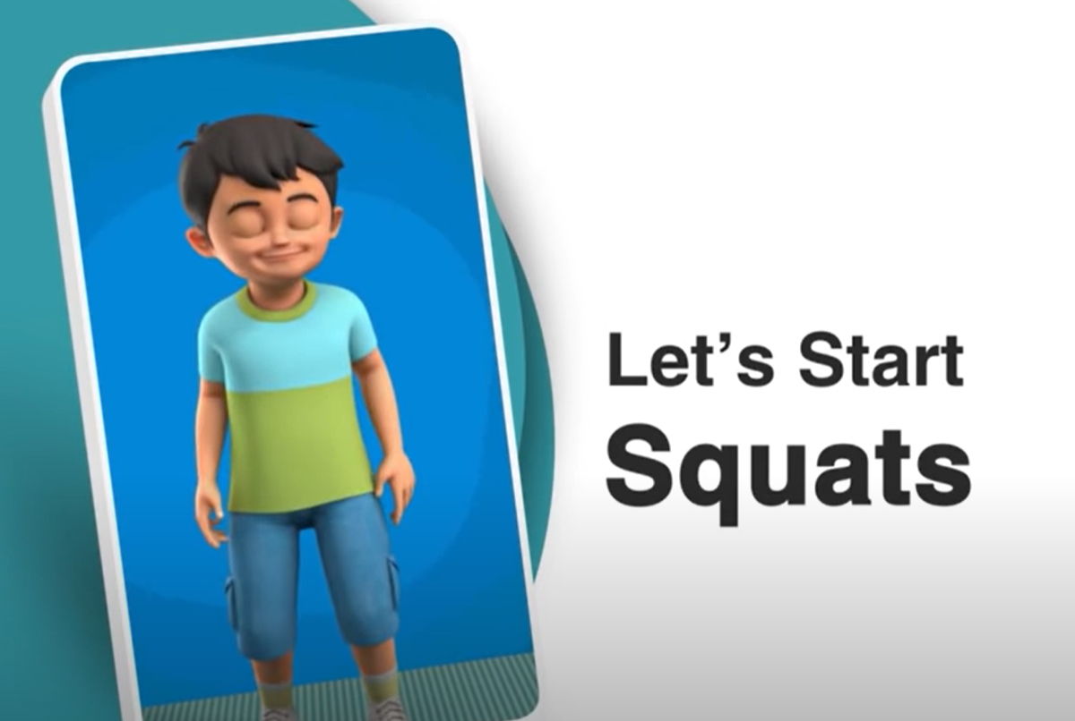
How to perform the squat correctly
https://www.youtube.com/watch?v=yXh9ktZ7FPY
www.sisa.com.au

Slide 5
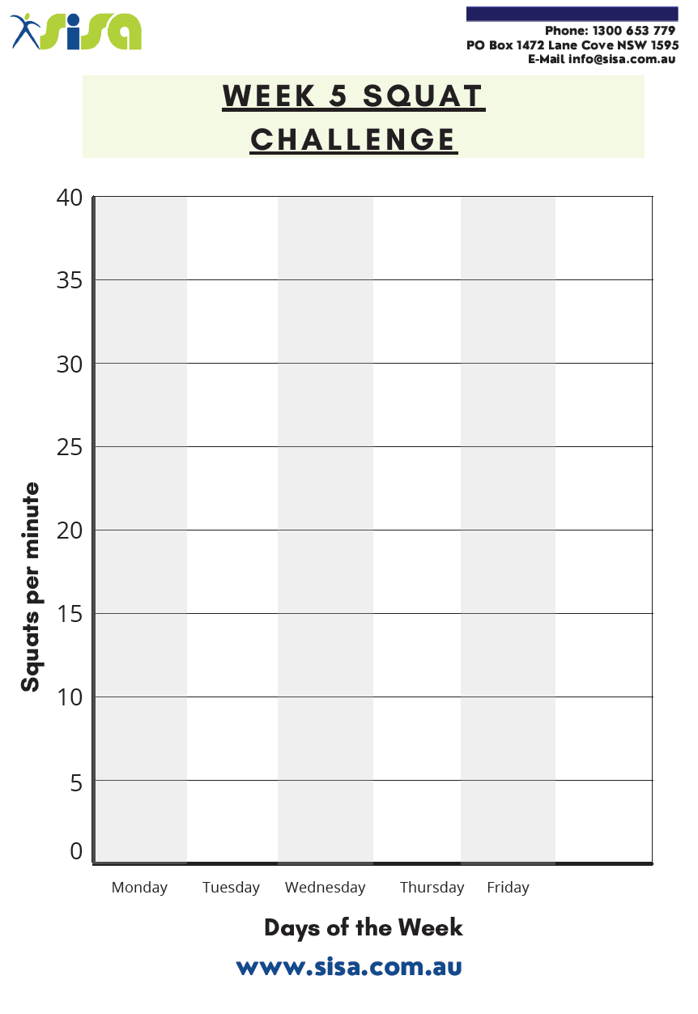
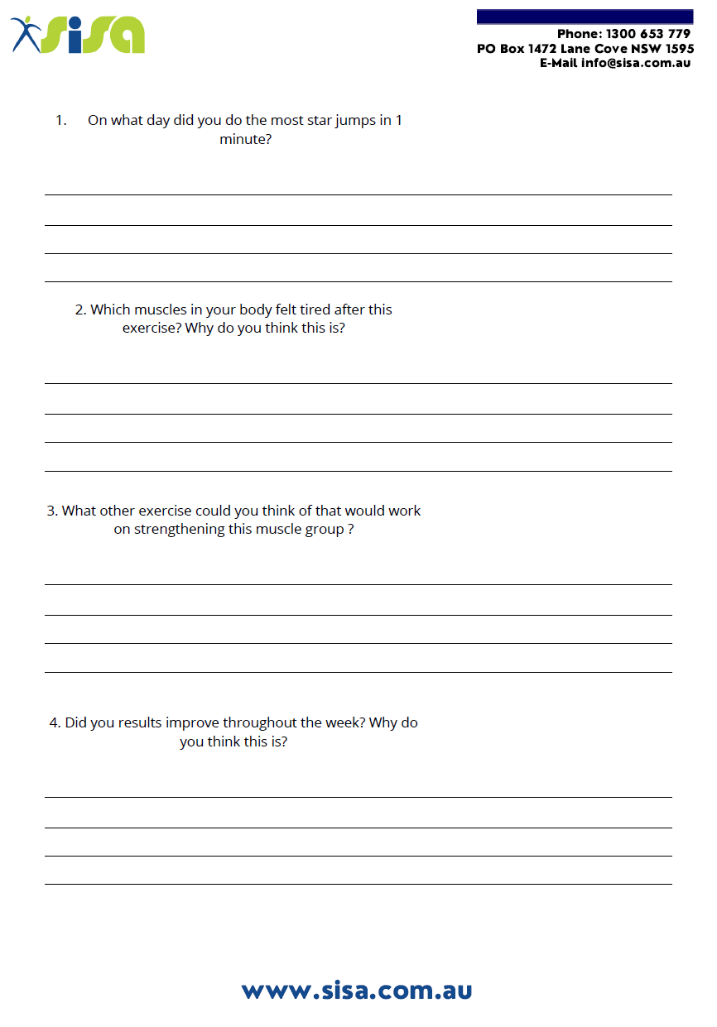
Your Turn !
Task: Each day complete the squat challenge and graph your results as you go.
At the end of the week, answer the questions to demonstrate your knowledge.
www.sisa.com.au

